Slide 1
Integrating Gender/Gender Based Violence programming into RMNCAEH+N QoC Program
MOMENTUM Country and Global Leadership,
August 26, 2022

Slide 2
Introduction- Gender Integration in Health programming
Gender equality integration in RMNCAEH+N is premised on the understanding that male and female community members have different needs and often-unequal status both at community demand and supply side levels of a health system.
From the level of community-based to tertiary care, gender-based inequities and inequalities negatively affect services – health promotion, preventive, curative.
RMNCAH services are particularly impacted by gender determinants such as gender norms, gender relations and inequalities which inhibit women from seeking health services for themselves and their families
  Gender norms affect clients’ health and health seeking behavior
  Gender stereotypes impact on client- provider interaction
  Gender impacts on providers own lives within the work and home environment
  Gender norms around sex and reproduction are particularly strong especially in patriarchal societies
All these can be addressed through gender sensitive RMNCAEH+N quality of care programming

Slide 3
Principles of Gender Sensitive Service Delivery
Equality
Equity
Non-discrimination
Participation

Slide 4
Equity
Health service delivery should strive for equity.
Equal health outcomes between women and men benefit society as a whole.
This does not mean that each individual should receive the same treatment and access to services
Rather, they receive fair access and treatment they need to realize equal health outcomes

Slide 5
Equality
Everybody has a right to access services that are safe and responsive to their needs.
Services are equally accessible to women, men, adolescent girls and adolescent boys, and other gender identities

Slide 6
Non-discriminatory
Providers do not discriminate against any clients
All patients receive equally respectful, compassionate care, regardless of: gender, age, marital status, sexual orientation, ethnicity, religion or whether they have given birth to a girl or boy

Slide 7
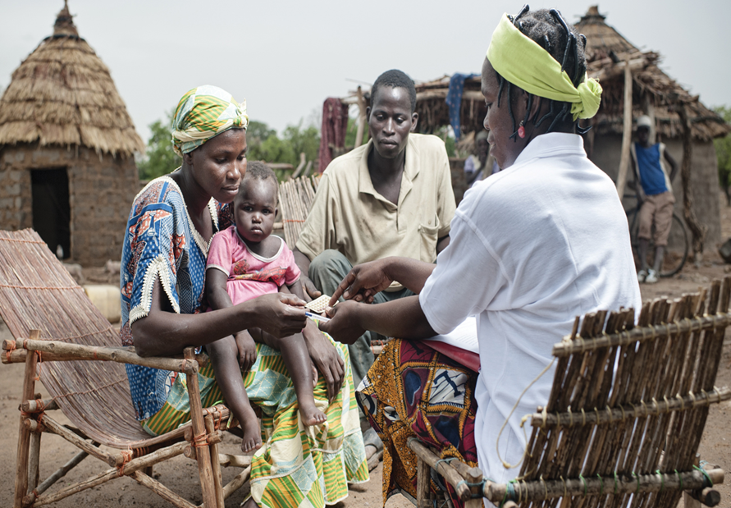
Participation
Providers take into account gender barriers that impact health-seeking and utilization of services and ensures maximum participation by the client.
E.g. The provider establishes a cordial and respectful relationship with the client and their companion (if present).

Slide 8
Four A’s of a gender-sensitive Service Delivery
Availability
Services available 24 hours 7 days a week
Services provided with all sense of professionalism (dignity, standard and quality)
Accessibility
Location of health services accessible to all
Services equally accessible to all clients without discrimination
Affordability
Diagnosis must be accurate
Appropriateness
User fees affordable
Not exorbitant and exploitative
Care and services appropriate to need
Standard operating procedures adequately followed

Slide 9

Introduction- Gender-Based Violence
Gender-based violence (GBV)
Humans rights violation and public health problem
Harmful act without a person’s permission that is based on socially ascribed (gender) differences
Rooted in gender inequality hence, women and girls are disproportionately because of existing gender inequality

Slide 10
Forms of GBV Prevalent in Nigeria
sexual violence
intimate partner violence
child marriage/ forced marriage
physical abuse
Rape/sexual coercion
sexual assault
harmful traditional practices
female genital mutilation
forced prostitution
trafficking and exploitation
technology-facilitated GBV
Disrespect and Abuse during child birth

Slide 11
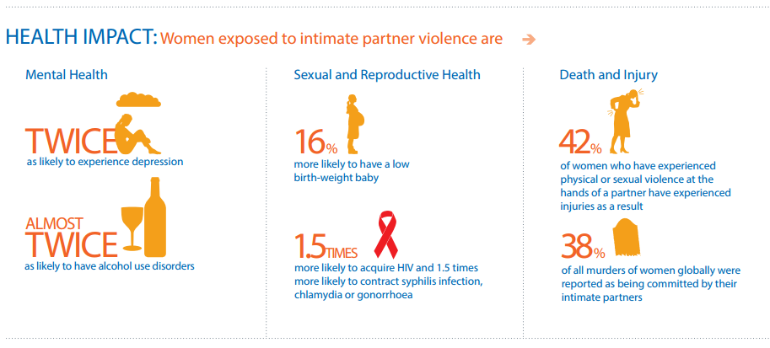
Health Implications of Gender-Based Violence
While GBV has negative economic and financial consequences, as well as adverse social consequences, perhaps the most important costs of GBV are health-related. The health threats of GBV are pervasive and in some cases deadly, with fatal outcomes.
Pathways and Health Effects of Intimate Partner Violence (WHO, 2013. Global and Regional Estimates of Violence Against Women)

Slide 12
Health Implications of Gender-Based Violence
The health implications of sexual violence often include | In cases of early and forced marriages | Violence during pregnancy also has higher risks of
unintended pregnancies | predispose children and women to STIs | late entry into prenatal care; Miscarriage, unsafe abortion bleeding in late pregnancy;
unsafe abortions | cervical cancer, malaria | premature delivery, stillbirth; low-birth-weight/small-for-gestational-age infants;
sexually transmitted infections (STIs) and HIV | unplanned pregnancies death during childbirth | fetal injury;
 | obstetric fistulas. | poor maternal weight gain; Maternal mortality
 | Children born are at increased risk for premature birth or as infants, or children.

Slide 13

Intimate Partner Violence & Pregnancy
According to the WHO, 23-40% of African women have experienced GBV while pregnant
IPV may be more common among pregnant women than pre-eclampsia or
gestational diabetes in some settings — conditions routinely screened for in prenatal care.

Slide 14

The Role of the Health Sector in GBV Response
Critical in responding to GBV, and providing support to GBV survivors,
For survivors of violence, health professionals are frequently the first point of contact.
This gives them an opportunity to intervene, to provide support, and also to refer to other responders including police, legal aid, and other government services.
support GBV survivors by reframing violence as a health problem
allows for multiple interactions between women and healthcare providers throughout their lives,

Slide 15
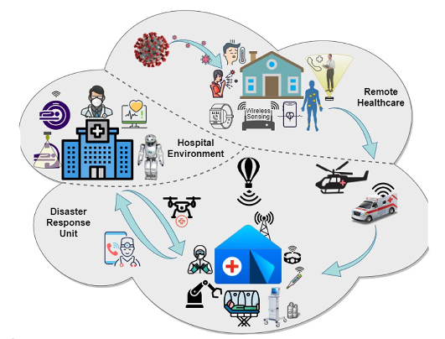
The Role of the Health Sector in GBV Response
In some settings, such as maternity care, outpatient departments, and family planning services, health care providers play a critical role in detecting, listening, caring, and referring for relevant services
Without proper training, health professionals may only treat the immediate complaints and miss opportunities to provide more comprehensive and holistic care to victims of gender-based violence

Slide 16
Integrating Gender into RMNCAH+N QoC Work
Promoting gender sensitive service delivery
Promoting Male engagement
Addressing gender based violence as a risk factor for RMNCAH (globally 35% of women have experienced physical and/or sexual intimate partner violence or non-partner violence) with significant health impact;
Eliminate disrespect and abuse at the facility level through capacity building of health care workers (RMC, Health workers for change)
Routine screening for GBV, Identification and Case Management
Enlisting GBV service delivery quality indicators into QoC framework and indicators being tracked
Building on strengths and opportunities
Coordination with GASHE division of the FMoH

Slide 17
MCGL (GBV) work on GBV/FP/ANC Integration
Introduction:
MCGL- Gender Based Violence Prevention and Response Activity is a four year USAID funded program working to prevent and Mitigate gender-based violence (GBV), childhood early forced marriage (CEFM) and promote early family planning (FP) in Ebonyi and Sokoto State
Technical priorities
• Intimate Partner Violence (IPV)
• Sexual Violence (SV)
• Child early and forced marriage (CEFM)
• Early adoption of family planning
• Capacity building of local partners

Slide 18
GBV Primary Prevention –(Community)
Strengthening GBV primary prevention and empowering communities, to mobilize actions transform discriminatory gender and social norms that continue to drive GBV
Working with communities to roll out SASA Together approach as well as Choices, Voices and Promises
Capacity building of local community leaders/groups on GBV norms shifting activities
Strengthened local leader engagement in GBV prevention and response activities across sectors
Development of GBV action plans at all levels (national, state, and local) in process
Capacity building of Local Partners to conduct behavioral analysis for strategy/program design

Slide 19
GBV Secondary Prevention- (HEALTH Facility)
Training package for GBV-first-line response and counseling, including screening tools and job aids, adapted using ARCHES and WHO curriculums
Capacity built for healthcare workers to provide survivor-centered post-GBV first line response, provision of post-partum family planning (PPFP) and adolescent friendly service delivery
Increased access to survivor-centered GBV services at health facilities that meet WHO's minimum
Institutionalized Routine GBV screening at health facilities for GBV case identification and management
Facilitated establishment of linkages between social services and health services at all levels for post GBV care

Slide 20
DATA MANAGEMENT- GBV Service Provision
Collation: Facility GBV focal or record officer (if available) is responsible for aggregating data on a monthly bias.
Reporting: Monthly reports are sent using the national HMIS MSF and MCGL MSF. Due to the absence of indicators on GBV screening (from the national), a customized version was created. The MCGL version also enables us to pick detailed disaggregates of forms of violence such as physical, psychological, emotional, sexual and IPV/non-IPV dimensions. Other details (not found in national) include what the client was referred for e.g. PEP, Emergency Contraception etc.
Validation: Source documents are checked for data availability, consistency, completeness and validity at the LGA before entry into the system
Reporting Timelines: MCGL also follows national guidelines in reporting and ensure LGA M & E Officers upload data for all facilities within their LGA, with more emphasis on supported ones.
Sharing/Data Use: MCGL ensures data use at facility, LGA and state levels. For instance, QI meetings use the facility dashboard as part of the agenda i.e. review the data, interpret and take at least one aspect to improve over the next quarter as they keep repeating the cycle. LGA level data review meetings on quarterly basis are used to achieve data sharing and use. This is also replicated at the state level. Dashboards have also been created on DHIS2 for tracking performance indicators.
Collection/Documentation: We leverage existing tools and also use customized version, summarized in bullets below
  GBV Screening Register: This register is used to capture all clients screened at the priority units of ANC/FP and OPD.
  GBV Case Management Forms: A GBV case management form is like the ‘patient management form’ in this case but domiciled at the focal persons office.
  NHMIS OPD Register: We use the national register to capture cases seen and services received as noted in the appropriate columns. However, to assure confidentiality, a separate NHMIS OPD register is dedicated strictly for this purpose. Hence, data from the case management form gets summarized in the OPD.
  National Referral Forms and Registers: This is the same as the one in-use nationally as well.
  Norms shifting attendance sheets: For tracking attendance during CHOICES sessions at the community
  Community mobilization attendance sheets: For documenting attendance during community mobilization study
DATA QUALITY ASSURANCE : This happens throughout the cycle including timely reporting, LGA validation, Use of validation rules, desk review of reported data on DHIS, supportive supervision and periodic data quality assessments.

Slide 21
Facility level GBV Service Provision and Data Flow
Screening Register: This form, is placed in ANC, FP and OPD - used to collect age, sex, name and specific screening information to identify survivors as well as reported incidents (cases in their ‘active phase’)
Patient Assessment Form: Identified survivors are escorted to the GBV unit/focal person where a patient assessment form is used to collect detailed information, as well as other subsequent services provided to the client including referral.
NHMIS OPD Register: This register serve as the GBV register for the facility, to be filled by the GBV focal for only identified survivors after documenting the Assessment form.
Referral Form: This form is issued by the GBV focal for any client who requires additional services elsewhere, whether clinical/non-clinical service.
Referral Register: All referred clients are captured in this register whether GBV or not. However a copy of the register will be placed in the GBV unit for documenting GBV referrals
Monthly Summary Form: MCGL Monthly summary form will be used to collate GBV data according to the project disaggregation. GBV data will also go into the national MSF as contained in the NHMIS guidelines (based on indicators available)
National DHIS2: Following data validation of both NHMIS MSF and the MCGL MSF, LGA M & E Officers enter data on the platform while MCGL MSF data entry is done by Local Partners, according to stipulated timelines
Health Facility level (GBV Screening, identification of survivors, service provision according to minimum criteria etc.)
Screening Register (OPD, ANC, FP)
Service Provider
@ANC, OPD, FP etc.
Patient Assessment Form
Referral Form
GBV Focal
Person/Unit
OPD Register
Referral Register
Facility Record Officer
Monthly Summary Form (MCGL and NHMIS)
National DHIS2/MCGL DHIS2

Slide 22
Community Level GBV Service Provision and Data Flow
Community GBV/Referral Register: This register serves as the GBV register for documenting reported cases as well as referrals
Referral Forms: Community leader refers clients and issue referral forms depending on services that they wish to access
Norms Shifting Register: This form is for documenting norms shifting sessions.
Norms Shifting Process: Each cohort will meet four two times per month. A cohort is expected to completes all sessions within a quarter i.e. 10-12 sessions
Community Mobilization: Each Activist will hold conduct mobilization sessions twice per month using power poster and community conversation.
Community Monthly Summary Form: For reporting community data on a monthly basis. LPs will follow up to ensure data is collated and reported whenever they ‘touch base’ with the CHOICES facilitators and Community Activists (SASA Together)/Survivor Advocates
Eligibility criteria for reporting Norms Shifting: Those participating in at least 10 sessions. Reporting frequency is every quarter
Community level (GBV incident reporting, documentation and referral; Norms shifting activities; Community Mobilization)
GBV Incidence Reporting and Referrals
GBV Prevention (Norms shifting sessions with CHOICES and community mobilization by Community Activist/Leaders)
Incident reporting by individuals
Religious Leaders
Adolescents etc.
Women Groups
Youth Groups
Survivor Advocates documenting and actively referring clients to other services such as health, legal aid, law enforcement etc.
Community Leaders/Activists/Facilitators actively facilitating norms shifting sessions/community mobilization and documenting appropriately
Community GBV/Referral Register
Community Referral Form
Other target Groups
Men Groups
Attendance sheets
Norms shifting Register/Form
REDCAP (cMSF – to track total referrals per LGA and destinations)
REDCAP (to track attendance at meetings)
MCGL Indigenous Partners provide support to ensure Community leaders are facilitating referrals and documenting accordingly, including routine reports which goes into REDCAP on a monthly basis.
MCGL IPs providing support to ensure sessions are held as planned with relevant documentation done. Responsible for ensuring data feeds into REDCAP.

Slide 23
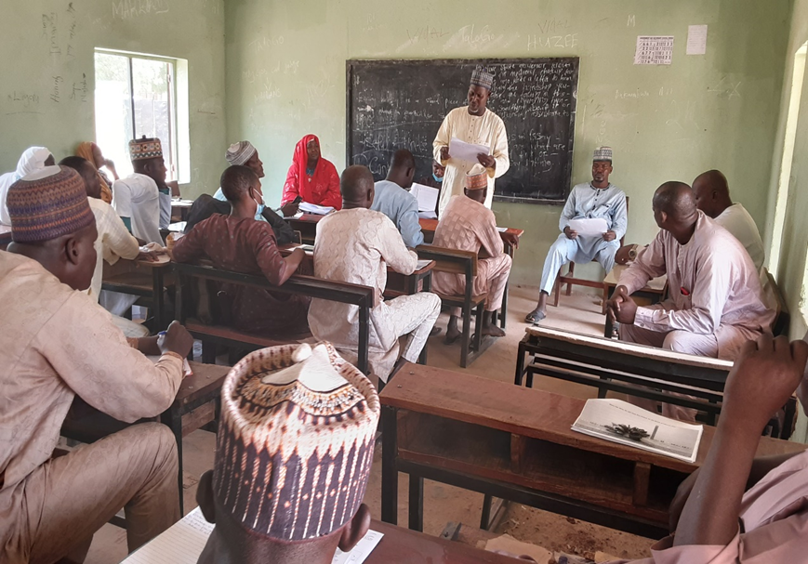
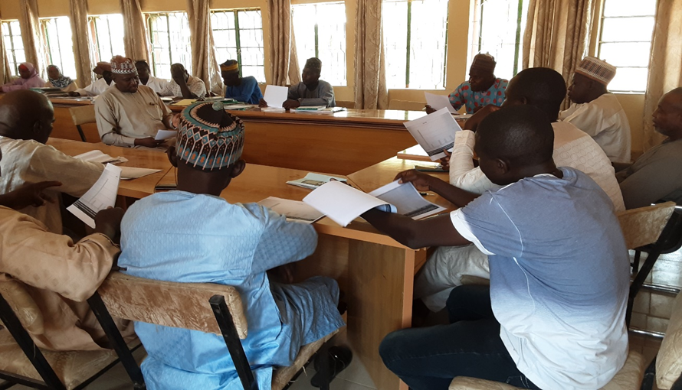
LGA Data-driven Learning Meeting
MCGL facilitates quarterly one-day LGA level learning review meetings across supported LGAs in Sokoto and Ebonyi states as part of adaptive management.
Aim of the meeting is to facilitate learnings and experiences from supported sites; build the capacity of facility staff on data interpretation and use; and discuss key challenges by health facilities.
Participants include facility GBV focal point and record officer from each site, LGA M & E Officer, PHC Coordinator, MCH Focal Person, Social Welfare Officer amongst others.
Highlights include:
  Presentation on data trends from each supported sites in the LGA especially on key indicators such as percentage of clients screened for GBV, identified, received services etc.
  Discussions following the presentation and experience sharing, especially on how the 'high performing sites' were able to achieve 100% screening vs the challenges of others.
  Emerging challenges identified by some facilities include poor uptake of screening due to overwhelming number of attendees on clinic days, 'under staffing' etc.
  Part of the suggested resolutions include staggering clinic days and scheduling such that all clients don't have to come on the same day.

Slide 24
Quality Improvement Team Meetings
Conduct routinely at the sites (MCGL supports 1 meeting per quarter)
Team has representatives from all units at the facilities, with special emphasis on ANC, FP, OPD, Immunization, Labor and Delivery, PNC etc.
Comprised of a Coordinator and Secretary who ensures the meetings are held and proper note taken.
Session discussion include data review (facility data for the quarter as well as facility reassessment results), which are usually generated prior to the meeting.
Low hanging fruits are picked and recommendations implemented within the next quarter
How far implementation has gone/achievements are evaluated at subsequent meetings

Slide 25
Percentage Screened for GBV @ OPD, ANC and FP
Positive trend observed in percentage of clients screened at the various units, particularly ANC and Family Planning.
Most significant improvement in screening rate observed at family planning unit for both states.
Both states seems to have recorded the least improvements at OPD. The dip for OPD was due to the updated ‘age cut-off’ for screening of clients which is now pegged at 15 years and above. The denominator (total attendance) has not been adjusted yet – to be reflected in next quarter report (as we have updated the reporting form to capture the specific age disaggregation for OPD attendance).
Additional reasons while 100% screening may not be achievable in ‘most cases’ is due to ‘lack of manpower’ as the OICs trained (especially in Ebonyi) are regularly occupied with one meeting or the other at the state HQ and volunteers left to do the job. MCGL is now focusing on on-the-job mentoring for the volunteers who often received little or no step down trainings from the OICS/2ICs. Furthermore, the project is exploring how to motivate the volunteers because they have complained of not been allowed to attend meetings, despite doing the bulk of the work.

Slide 26
Positive trend in number identified vs received services (Quarterly comparison)
Non-IPV
Chart shows positive trend in case identification in both states, which could be as a result of more persons screened.
As expected, more females were identified compared to males.
Almost all identified clients received services (98% in Ebonyi and 92% in Sokoto)

Slide 27
Disaggregation by relationship with perpetrator and type of violence (Quarter 3 only)
IPV cases identified (Ebonyi)
Non IPV cases identified (Ebonyi)
IDENTIFIED
IPV | Males |  |  | Females
EBONYI | <20 years | 20 - 49 years | 50yrs + | <20 years | 20 - 49 years | 50yrs +
Physical | 1 | 19 | 1 | 21 | 172 | 6
Sexual | 3 | 2 | 0 | 8 | 37 | 0
Psychological | 0 | 4 | 0 | 5 | 18 | 1
Emotional | 1 | 9 | 0 | 5 | 100 | 6
IDENTIFIED
Non IPV | Males |  |  | Females
EBONYI | <20 years | 20 - 49 years | 50yrs + | <20 years | 20 - 49 years | 50yrs +
Physical | 4 | 15 | 5 | 9 | 53 | 4
Sexual | 3 | 2 | 0 | 3 | 11 | 0
Psychological | 1 | 4 | 0 | 3 | 9 | 0
Emotional | 2 | 6 | 0 | 4 | 8 | 1
IPV cases identified (Sokoto)
Non IPV cases identified (Sokoto)
IDENTIFIED
IPV | Males |  |  | Females
SOKOTO | <20 years | 20 - 49 years | 50yrs + | <20 years | 20 - 49 years | 50yrs +
Physical | 31 | 50 | 4 | 66 | 352 | 16
Sexual | 1 | 2 | 0 | 16 | 40 | 0
Psychological | 13 | 15 | 3 | 31 | 280 | 12
Emotional | 19 | 69 | 4 | 152 | 984 | 16
IDENTIFIED
Non IPV | Males |  |  | Females
SOKOTO | <20 years | 20 - 49 years | 50yrs + | <20 years | 20 - 49 years | 50yrs +
Physical | 22 | 44 | 1 | 43 | 119 | 2
Sexual | 4 | 0 | 0 | 24 | 34 | 0
Psychological | 4 | 6 | 2 | 19 | 100 | 1
Emotional | 23 | 30 | 1 | 39 | 151 | 2
IPV and Non IPV Disaggregation: It appears IPV was the dominant form of violence experienced in Sokoto by both male and females while Ebonyi recorded more of IPV for females and ‘balanced’ proportion between IPV and Non IPV for males.
Emotional violence is the highest (20 – 49 years) form of violence identified in Sokoto state followed by Physical violence while Sexual was the least. Sexual violence was also the least form of violence in quarter 2.
In contrast, Ebonyi state had more of Physical violence cases than Emotional violence. Least form of violence in Ebonyi was psychological which is consistent with quarter 2 findings.

Slide 28
Summary (Cascade – quarter 3 only)
Ebonyi | Male |  |  | Female
 | <20 years | 20 - 49 years | 50 years & above | <20 years | 20 - 49 years | 50 years & above
Screened | 5100 | 7649 | 1205 | 6748 | 24597 | 1608
Identified | 15 | 61 | 6 | 58 | 408 | 18
Received services | 15 | 61 | 6 | 58 | 399 | 18
Comparison of the tables generally show higher preponderance of GBV cases amongst U20 and 20-49 years in Ebonyi as well as Sokoto.
More cases were identified in Sokoto compared to Ebonyi, cutting across all the different forms of violence
Most of the identified cases received basic psychosocial support counseling
Sokoto | Males |  |  | Females
 | <20 years | 20 - 49 years | 50 years & above | <20 years | 20 - 49 years | 50 years & above
Screened | 2154 | 22138 | 1750 | 5748 | 43420 | 2644
Identified | 117 | 216 | 15 | 390 | 2060 | 49
Received services | 115 | 200 | 15 | 356 | 1924 | 47
Please note that the cases documented here are mostly (picked by service providers following screening) and not reported cases. We have modified our tools to pick reported incidences and now mentoring facility staff. Reported GBV incidences data will be available in Quarter 4.

Slide 29
Proposed GBV Indicators for integration into QoC
Percentage of persons screened for GBV at ANC (Not available on NHMIS)
Percentage of persons screened for GBV at FP (Not available on NHMIS)
Percentage of persons screened for GBV at OPD (Not available on NHMIS)
Percentage of persons receiving post-GBV services (available on NHMIS)
Number of facilities that meet the minimum criteria for provision of GBV services

Slide 30

Questions

Slide 31
THANK YOU
This presentation is made possible by the generous support of the American people through the U.S. Agency for International Development (USAID) under the terms of the Cooperative Agreement #7200AA20CA00002, led by Jhpiego and partners. The contents are the responsibility of MOMENTUM Country and Global Leadership and do not necessarily reflect the views of USAID or the United States Government.

