Slide 1
MOMENTUM Country and Global Leadership: Quality of Care Project
Advancing RMNCAEH+N Quality of Care in Nigeria: Respectful Maternity Care & Assessment of Patient Experience
February 8th 2023

Slide 2
Outline
What is Respectful Maternity Care?
Types and drivers of Respectful Care (Client & Providers)
Dimensions of disrespect and abuse
Promising RMC Approaches
Case Studies – USAID/IHP Open Maternity Day & MSD for Mothers RICOM3 Project
What Women Want Campaign (WRA)
What the National RMNCAEH+N QoC TWG is doing about RMC/Patient Experience Assessment
Recommendations
2

Slide 3
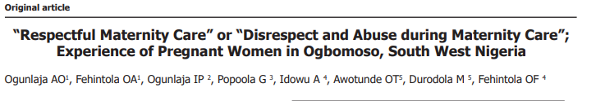
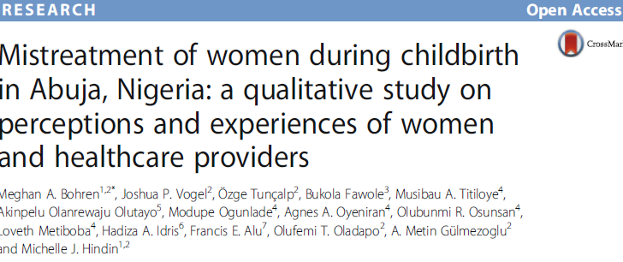
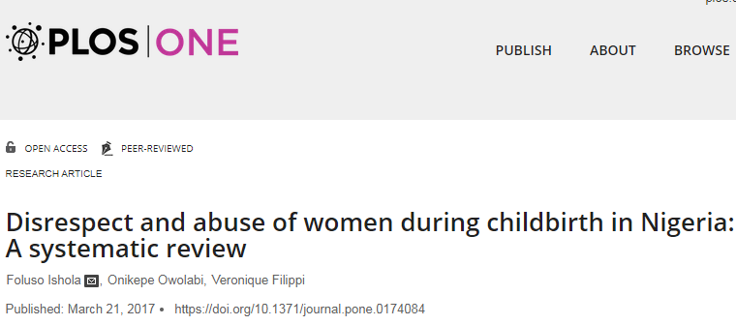
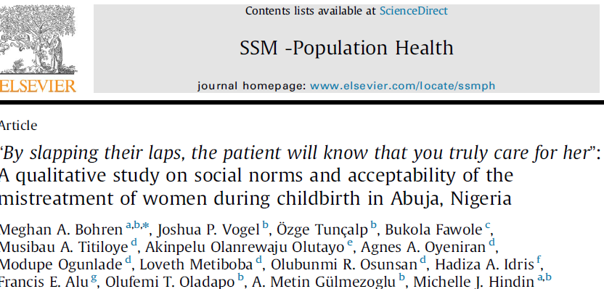
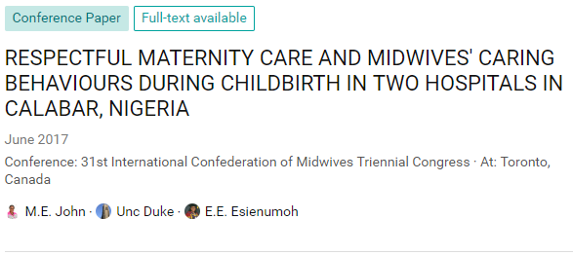
Publications on Evidence of Disrespect and Abuse and RMC in Nigeria
A lot has been written in peer-review journals on disrespect and abuse in pregnancy and childbirth in Nigeria

Slide 4
Respectful Maternal Care (RMC) refers to the humane and dignified treatment of a child bearing woman throughout her pregnancy, birth, and post natal period.
Respectful Maternity Care encompasses respect for women’s basic human rights and includes respect for the autonomy, dignity, feelings, choices and preferences, including companionship during maternity care
Notes:
Maternal mortality ratio (MMR) in several low-and-middle-income countries is alarming, with about 34% of global maternal deaths occurring in Nigeria and India alone.¹ According to the World Health Organization (WHO), the MMR of Nigeria is 814 (per 100,000 live births).¹ The lifetime risk of a Nigerian woman dying during pregnancy, childbirth, postpartum or post-abortion is 1 in 22, in contrast to the lifetime risk in developed countries estimated at 1 in 4900.² Current evidence suggests that the high rate of maternal and neonatal mortality in Nigeria is linked to the three forms of maternal delay proposed by Thaddeus and Marine.^{3,4} These barriers include delay in making decision to seek maternal health care; delay in locating and arriving at a medical facility; and delay in receiving skilled pregnancy care when the woman gets to the health facility.

Slide 5
“Safe motherhood must be expanded beyond the prevention of morbidity or mortality to encompass respect for women’s basic human rights, including respect for women’s autonomy, dignity, feelings, choices and preferences”
Source – Reis et al 2012

Slide 6
WHO Quality of Care Framework for Maternal and Newborn Health
Health System
Structure
Quality of Care
Box I: Dimensions of quality of care
• Safe – delivering health care that minimizes risks and harm to service users, including avoiding preventable injuries and reducing medical errors
• Effective – providing services based on scientific knowledge and evidence-based guidelines
• Timely – reducing delays in providing and receiving health care
• Efficient – delivering health care in a manner that maximizes resource use and avoids waste
• Equitable – delivering health care that does not differ in quality according to personal characteristics such as gender, race, ethnicity, geographical location or socioeconomic status
• People-centred – providing care that takes into account the preferences and aspirations of individual service users and the culture of their community
Source: WHO, 2006; Tuncalp et al, 2015.
PROVISION OF CARE
EXPERIENCE OF CARE
Evidence based practices for routine care and management of complications
Actionable information systems
Functional referral systems
Effective communication
Respect and preservation of dignity
Emotional support
Process
Competent, motivated human resources
Essential, physical resources available
Individual and facility level outcomes
Outcome
Coverage of key practices
People-centered outcomes
Health outcomes

Slide 7
Experience of Care Domains and Standards (WHO)
Effective Communications
Standard 4: Communications with women and their families is effective and responds to their needs and preferences
Respect and Preservation of Dignity
Standard 5: Women and newborns receive care with respect and can maintain their dignity
Emotional Support
Standard 6: Every woman and her family are provided with emotional support that is sensitive to their needs and strengthens the woman’s capabilities

Slide 8
Types and Drivers of Respectful Maternity Care
CLIENTS
All forms of Disrespect and Abuse (Emotional, physical and verbal)
No privacy during treatment
Stigma and discrimination
Poor communication with client
Lack of information to clients about their care
Detention of clients for lack of payment of hospital bills
HEALTH CARE WORKERS
Underpayment of health care providers
Harassment by colleagues, clients and management
Difficult working conditions
Over crowding
Understaffing

Slide 9
Dimensions of Disrespect and Abuse and Respectful Maternity Care
Types of Abuse and Disrespect | Human Right in Maternity Care
1. Physical abuse | Freedom from harm and ill treatment
2. Non‐consented care | Right to information, informed consent and refusal, and respect for choices and preferences, including the right to companionship of choice wherever possible
3. Non‐confidential care | Confidentiality, privacy
4. Non‐dignified care (including verbal abuse) | Dignity, respect
5. Discrimination based on specific attributes | Equality, freedom from discrimination, equitable care
6. Abandonment or denial of care | Right to timely healthcare and to the highest attainable level of health
7. Detention in facilities | Liberty, autonomy, self‐determination, and freedom from coercion
Source: Bowser and Hill 2010

Slide 10
Selected Promising Approaches to Implementing RMC
RMC Approach | Brief Explanation
Advocacy and Policy work at National and Local Level | Developing Country policy on RMC starting with Adopting the WRA updated charter and making it available in health facilities across the country
Building the capacity of health care providers on RMC | This could focus on value clarifications and attitudes transformation, gender and human rights issues, health care workers for change, knowledge of GBV identification and response by health care providers
Open Maternity Days | A opportunity for pregnant women and their families to interact with health care providers, visit the maternity unit to help understand what to expect during labor and delivery, and quell any fears they may have about giving birth in a facility. Also fosters male engagement
Community Participatory approaches | Facility QI teams incorporating members from the community, joint community and facility mechanisms to resolve disputes such as detention of women for inability to pay hospital bills after delivery, community participation also encourages male engagement
Notes:
These are just selected evidence based approaches to Implementing RMC

Slide 11
Selected Promising Approaches to Implementing RMC
RMC Approach | Brief Explanation
Continuous Quality Improvement at health facilities *Periodic Patient experience assessment through exit interviews, surveys, FGD *Suggestion boxes simplified with infographics | Overcoming critical barriers to RMC, linked to regular measurement/assessment of women’s and families’ experience of care. Continuous QI involves feeding back the results from these assessments to facility QI teams for action and improvement.
Working with Professional Regulatory Bodies and Pre-service Institutions | Embed RMC principles within professional standards and pre-service curriculum and develop mechanisms to monitor implementation
Caring for the Carers | Provide opportunity for providers to deal with work-related pressures and develop sustainable processes within the MOH systems e.g. mentors/confidential counsellors, peer support groups to help health care workers to process work-related stress.
Strengthening Local Health Systems | Overcome structural barriers (lack of commodities, lack of basic infrastructure). Preventing and eliminating mistreatment in childbirth requires a “systems approach” to address underlying triggers.

Slide 12



A newly delivered mother cannot pay her facility bill. She is sent home to find the money to pay while the baby is kept in the facility, is this human rights violation? Why or why not

Slide 13

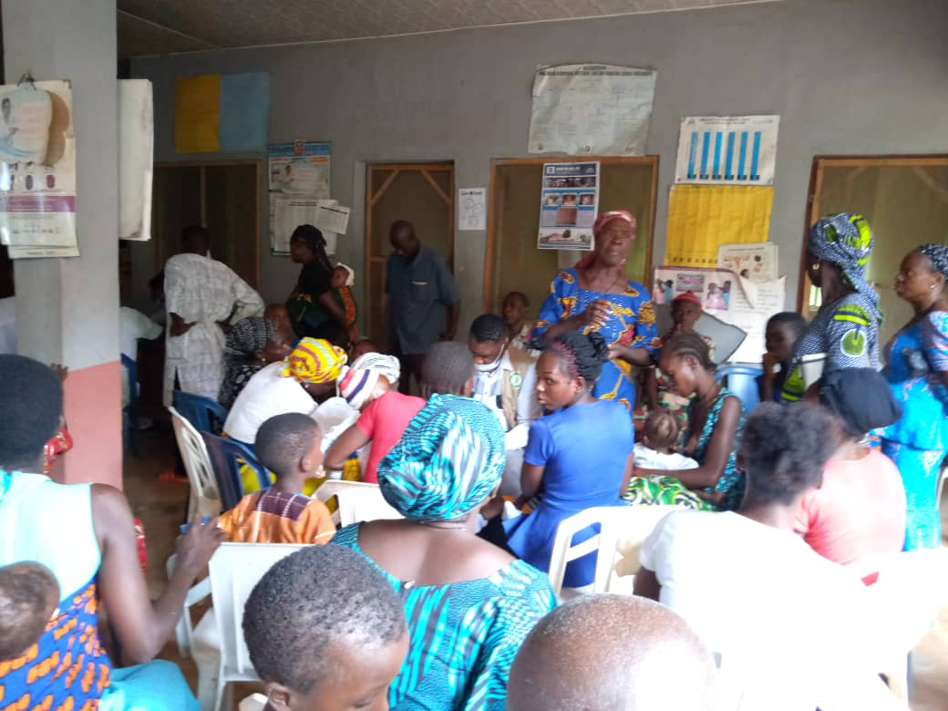
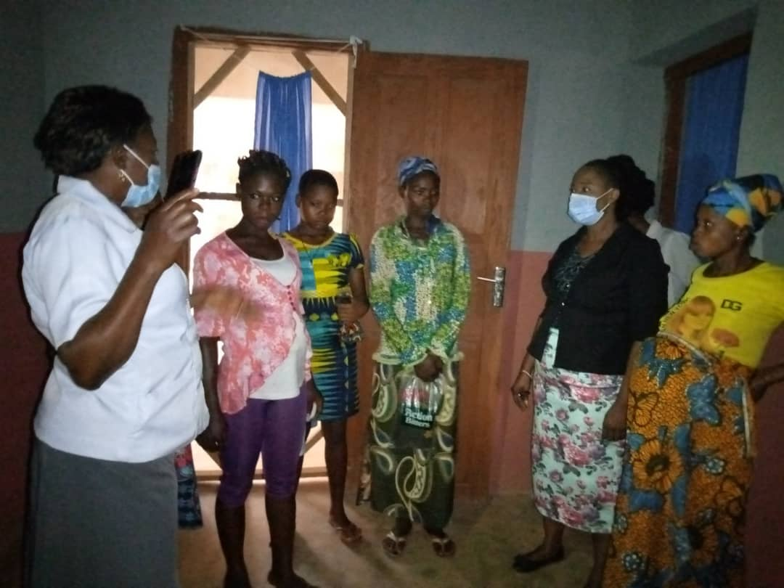
USAID INTEGRATED HEALTH PROJECT (IHP) Open Maternity Day in PHCs in Afikpo North Ebonyi July 2021
Notes:
Open Maternity Days creates demand for services

Slide 14
Case Study to Show Case Experience of Care:
“Periodic Assessment of Patient Experience as part of Quality Improvement in the MSD/RICOM3 Project Implemented in Lagos State and FCT”.

Slide 15
Project Overview – Reducing Indirect Causes of Maternal Mortality and Morbidity (RICOM3)
Geographic Area and Sites:
  Four LGAs (districts) in Two “States” - Lagos State and Federal Capital Territory (FCT)
  PHASE 1 (2019-2020) 20 Health Care Facilities (10 each state) – public and private hospitals and clinics
  PHASE II (2021-2022) 40 Health care facilities (20 each state)
OVERALL GOAL:
Reduce MMM from indirect causes by applying a QoC model to improve prevention, early detection and management of indirect causes of MMM associated with PE/E along a continuum of woman-centered public and private MH/RH services (ANC, childbirth, postnatal care, FP)
Project Clinical Focus Areas:
(indirect causes of MMM that increase risk for PE/E and premature Cardiovascular Disease)
Sokoto
Borono
Zamfara
Kastina
Yobe
Kebbi
Jigawa
Kano
Bauchi
High BP
(chronic/ gestational, PE/E)
Diabetes (chronic/ gestational)
Kaduna
Niger
Gombe
Adamawa
Kwars
Plateau
Nassarawa
Taraba
Oyo
Abuja
Kogi
Osun
Ekiti
Benue
Ogun
Ondo
Obesity
Anemia
Edo
Enugu
Cross
River
Lagos
Delta
Anambara
Ebonyi
Imo
Abia
Bayelsa
Rivers
Akwa
Ibom

Slide 16
Project Phase I (2019-2020): Assessment of women’s experience of ANC
Aim: To assess quality of antenatal care and women’s experience in receiving this care to inform areas for improvement and approaches for regular measurement .
Sample size: 100 pregnant women enrolled in ANC (at least 2 visits) randomly selected from 10 high volume health facilities in Lagos & FCT – a mix of general hospitals, private and primary health care facilities.
Client Questionnaire Tool: adapted with permission from Afulani et al, 2019 [Quality of Antenatal Care: an assessment of service provision and experience dimensions; BMC Health Services Research].
Data Collection & Analysis: June, 2020 using REDCAP; SPSS and Excel (analysis)
Notes:
Our focus is in providing the clinical indicators and patient experience whilst receiving care

Slide 17
Improved Quality of Care (Project Phase I): Improved Antenatal Screening for HTN, DM, Anemia in FCT and Lagos (Oct 2019-Sept 2020) (26,712 women enrolled in ANC in supported facilities)
Notes:
Phase one showed significant improved screening of pregnant women attending ANC for hypertension (HTN), Diabetes mellitus (DM), and anemia over a period of one year.

Slide 18
June 2020 Survey of Women: Women’s report of receiving ANC best practices corroborated many measured improvements in project QI indicator results - and revealed some remaining gaps
N=100 women beneficiaries of ANC services in 10 sites in the FCT & Lagos
Notes:
Provider Communication of Results Remains low and will be targeted in the scale up phase of the project as part of larger emphasis on person centred care

Slide 19
June 2020 Survey: Women’s Experience of Antenatal Care – Room for Improvement
(n=100 Women surveyed in 10 facilities in the FCT & Lagos State)
Notes:
There is still room for improvement in discussing issues in privacy, perception of clients/pregnant women being treated with respect and in a friendly manner by providers

Slide 20
June 2020 Survey: Women’s Experience of Antenatal Care Environment– Room for Improvement (n=100 Women surveyed in 10 facilities in the FCT & Lagos State)
Notes:
There is also room for improvement in making sure facilities are clean all the time especially the toilet areas

Slide 21
Challenges, Opportunities and Lessons Learned
Challenges
Opportunities and Lessons Being Learned
Regular measurement of RMC is essential – should not be a one off.
Possible to monitor and improve experience of care and clinical quality of care in an integrated MH/RH program
Stakeholders and facility involvement in the process is important for implementation
A collaborative process favors acceptance of results and willingness to work on needed improvements
Staff shortages lead to demotivation and negatively impact on respectful care
Getting cooperation from the health facilities for routine respectful care measurement
Patient Bias - finding an appropriate and convenient place to assess the woman beyond the health facility
COVID19 pandemic challenges related to women’s utilization of MH/RH services

Slide 22

What women want campaign (WRA)
In 2018, over 78,000 Nigeria women participated in the ‘What Women Want’ campaign
The What Women Want campaign is unique because it asked women and girls in Nigeria to set the agenda of what they want.

Slide 23
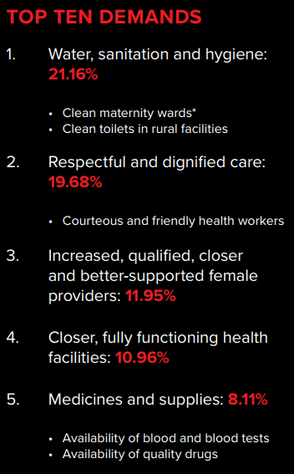
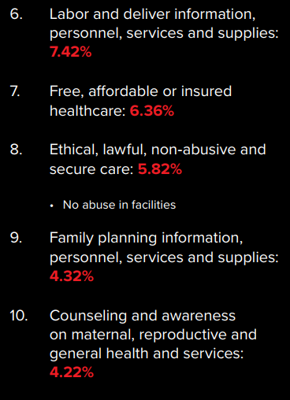
Top 10 demands from women and girls

Slide 24
National RMNCAEH+N QoC TWG Inputs to Experience of Care and RMC in 2021/2022

Slide 25
Call to Action from QoC TWG October 2021
The new RMC Charter should be actively used to raise awareness and create policy change in Nigeria

Slide 26
Universal Right of Women and Newborn
Everyone has the right to freedom from harm and ill-treatment
Everyone has the right to information, informed consent, and respect for their choices and preferences, including companion of choice during maternity care and refusal of medical procedures
Everyone has the right to privacy and confidentiality
Everyone is their own person from the moment of birth and has the right to be treated with dignity and respect
Everyone has the right to equality, freedom from discrimination and equitable care
Everyone has the right to healthcare and to the highest attainable level of health
Everyone has the right to liberty, autonomy, self-determination and freedom from arbitrary detention
Every child has the right to be with their parents or guardians
Every child has the right to an identity and nationality from birth
Everyone has the right to adequate nutrition and clean water

Slide 27
National RMNCAEH+N QoC Reporting Template – Experience of Care Indicators
Total number of women who reported that they were abused physically or verbally by health workers during delivery
Total number of women who had their companion of choice during delivery in all learning sites
Total number of women who were refused request to have their companion of choice during delivery in learning sites
Total number of reports of negative attitude of health workers
Total number of learning sites with single area or room that allows for privacy for women and companion of choice for all deliveries
Number of facilities with labour and delivery rooms organized to allow for private spaces

Slide 28
Opportunities: State Specific Actions Plans on how to document Experience of Care data
S/N | State | Methods/Ideas
1 | Kaduna | Leverage on complaint center in the state where clients/patients use to go for complaints in person and plans to expand to other facilities without a complaint centre.
2 | Yobe | Leverage on ISS/Mentoring session Leverage on partners supporting QoC to help them elicit the response for indicator 13-16
3 | Kastina | Leverage on the state network of TBAs, WhatsApp to report the indicators because they don’t currently have support on QoC.
4 | Kebbi | Leverage on Ward Development Committee at the community.
5 | Gombe | Leverage on the use of Village health Workers who also visit pregnant women and newly delivered women in the community.
6 | Ebonyi | Apply method used in getting community perinatal death, making available the phone number of RH and HMIS officer number’s available in the community Use Client Exit Interview Form.
7 | Adamawa | Meet with WDCs to help getting response from target respondents Client exit form, soliciting for funding support from partner to motivate those that will be conducting the exit interview
Notes:
Suggestions from the bi monthly virtual meetings with the National QoC 12 Learning States ad partners

Slide 29
Opportunities: State Specific Actions Plans on how to document Experience of Care data
S/N | State | Methods/Ideas
8 | Bauchi | Community Structure in the State, LGA and communities using WDCs
9 | Niger | Community Structure using community health influencers and promoters (CHIPS). Adding the indicators for the CHIPs agent to track
10 | Kano | Community Structure, then use the coaches to validate what has been obtained from the community using questionnaire/checklist.
11 | Sokoto | Using facility QI teams and advocate to the State government for stipend to be given to coaches to go to the community to get the responses. Also using the community volunteers.
12 | FCT | Exit Interview Leverage on RICOM3 NAVI health platform where clients are allowed to fill client satisfaction survey. Use manual client satisfaction survey tools to be administered by CHIPS. Calling client directly Use of Focus group discussions (FGDs)
13 | Rivers | Leveraging on the existing good communication system in the State Utilize the mentor mothers
14 | Ondo | Getting to understand what QoC is all about but for now explore the utilization of existing community structures (CHIPs and the community MPCDSR)

Slide 30


Working with Academic Institutions on RMNCAEH+N QoC Research in Partnership with FMoH
University of Iiorin – Topic: What are the factors influencing the implementation of the Respectful Maternity Care Charter in two selected States in the North Central Zone
Bayero University, Kano – Topic: Assessment of the Government of Nigeria’s implementation of RMNCAEH+N QoC for improved health outcomes
Alex Ekwueme University, Ebonyi State – Topic: Assessment of the best model for care of small and sick newborns
*Note: The Technical Subcommittee of the National RMNCAEH+N QoC TWG will cover RMC, Gender issues
30

Slide 31
Recommendations for RMC
Promote women’s rights and empower women to give birth with dignity
Implement and enforce policies on Respectful Maternity Care and Patients Bill of Rights
Facilitate provider behavior change by building the capacity of all clinical and non-clinical providers in health facilities on RMC
Develop job aids on RMC for ALL staff and IEC Materials such as wall posters, client’s information pamphlets, to clearly communicate RMC within and outside the facilities

Slide 32
Recommendations contd.
Regularly obtain feedback from clients to enhance health care quality improvement.
Strengthen the health systems to respond to specific needs of women at childbirth e.g. having a companion at childbirth
Recognize and reward institutions and individuals that promote RMC
Support more robust research to explore disrespect and abuse of women during childbirth in Nigeria
Finally, become intentional in ensuring that all women and newborns are provided with compassionate, dignified and respectful childbirth care as a fundamental human right.

Slide 33
THANK YOU
This presentation is made possible by the generous support of the American people through the U.S. Agency for International Development (USAID) under the terms of the Cooperative Agreement #7200AA20CA00002, led by Jhpiego and partners. The contents are the responsibility of MOMENTUM Country and Global Leadership and do not necessarily reflect the views of USAID or the United States Government.

